Slide 1


SQL
Coronavirus Analysis using
SQL

Slide 2
CORONA VIRUS
THE CORONA VIRUS PANDEMIC HAS HAD A SIGNIFICANT IMPACT ON PUBLIC HEALTH AND HAS CREATED AN URGENT
NEED FOR DATA-DRIVEN INSIGHTS TO UNDERSTAND THE SPREAD OF THE VIRUS.

Slide 3
INTRODUCTION
.
The objective of this project was to explore and analyze COVID- 19 data using SQL in MYSQL workbench.
The Project aimed to gain insights into various aspects of the COVID-19 pandemic, such as cases Confirmed, deaths and recovered percentages.

Slide 4
DATASET:
DESCRIPTION OF EACH COLUMN IN DATASET:
PROVINCE: GEOGRAPHIC SUBDIVISION WITHIN A COUNTRY/REGION.
COUNTRY/REGION: GEOGRAPHIC ENTITY WHERE DATA IS RECORDED
.
LATITUDE: NORTH-SOUTH POSITION ON EARTH'S SURFACE.
LONGITUDE: EAST-WEST POSITION ON EARTH'S SURFACE.
DATE: RECORDED DATE OF CORONA VIRUS DATA.
CONFIRMED: NUMBER OF DIAGNOSED CORONA VIRUS CASES.
DEATHS: NUMBER OF CORONA VIRUS RELATED DEATHS.
RECOVERED: NUMBER OF RECOVERED CORONA VIRUS CASES.

Slide 5
CHECK TOTAL NUMBER OF ROWS
CHECK WHAT IS START_DATE AND END_DATE
NUMBER OF MONTH PRESENT IN DATASET
FIND MONTHLY AVERAGE FOR CONFIRMED, DEATHS, RECOVERED
FIND MOST FREQUENT VALUE FOR CONFIRMED, DEATHS, RECOVERED EACH MONTH
FIND MINIMUM VALUES FOR CONFIRMED, DEATHS, RECOVERED PER YEAR
FIND MAXIMUM VALUES OF CONFIRMED, DEATHS, RECOVERED PER YEAR
THE TOTAL NUMBER OF CASE OF CONFIRMED, DEATHS, RECOVERED EACH MONTH
CHECK HOW CORONA VIRUS SPREAD OUT WITH RESPECT TO CONFIRMED CASE
(EG.: TOTAL CONFIRMED CASES, THEIR AVERAGE, VARIANCE & STDEV )
CHECK HOW CORONA VIRUS SPREAD OUT WITH RESPECT TO DEATH CASE PER MONTH
(EG.: TOTAL CONFIRMED CASES, THEIR AVERAGE, VARIANCE & STDEV )
CHECK HOW CORONA VIRUS SPREAD OUT WITH RESPECT TO RECOVERED CASE
(EG.: TOTAL CONFIRMED CASES, THEIR AVERAGE, VARIANCE & STDEV )
FIND COUNTRY HAVING HIGHEST NUMBER OF THE CONFIRMED CASE
FIND COUNTRY HAVING LOWEST NUMBER OF THE DEATH CASE
FIND TOP 5 COUNTRIES HAVING HIGHEST RECOVERED CASE

Slide 6
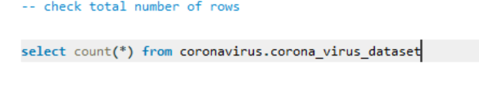
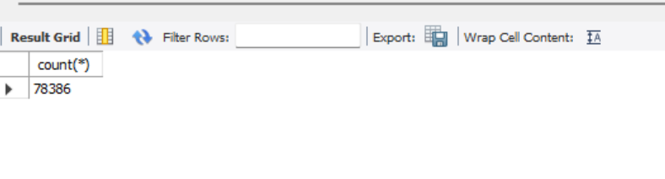
CHECK TOTAL NUMBER OF ROWS

Slide 7
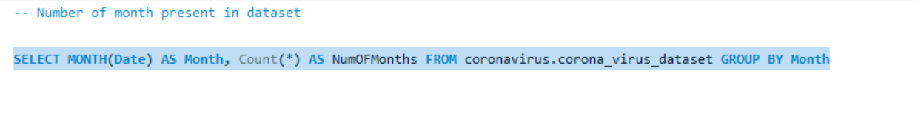
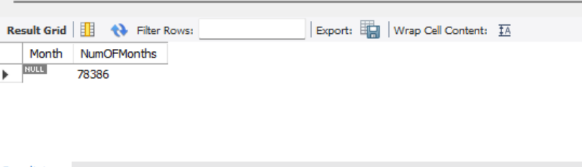
NUMBER OF MONTH PRESENT IN DATASET

Slide 8
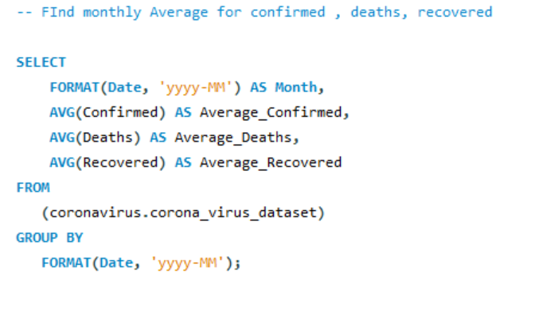
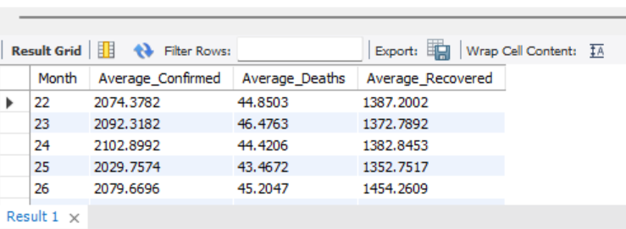
FIND MONTHLY AVERAGE FOR CONFIRMED, DEATHS, RECOVERED

Slide 9
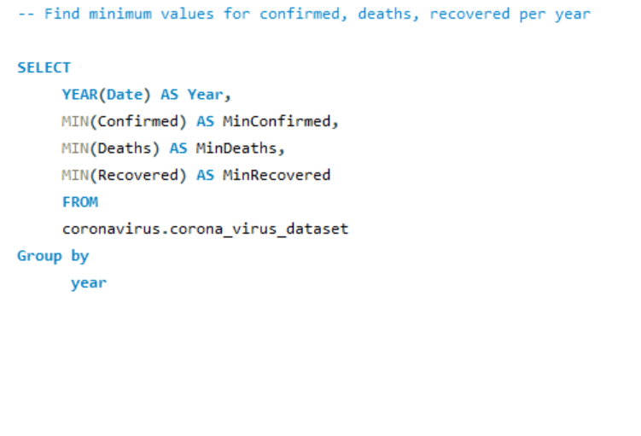
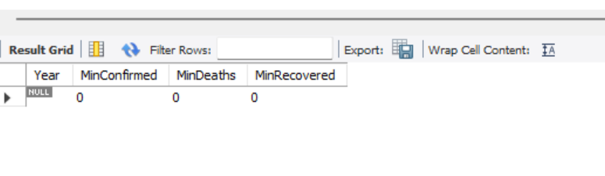
FIND MOST FREQUENT VALUE FOR CONFIRMED, DEATHS, RECOVERED EACH MONTH

Slide 10
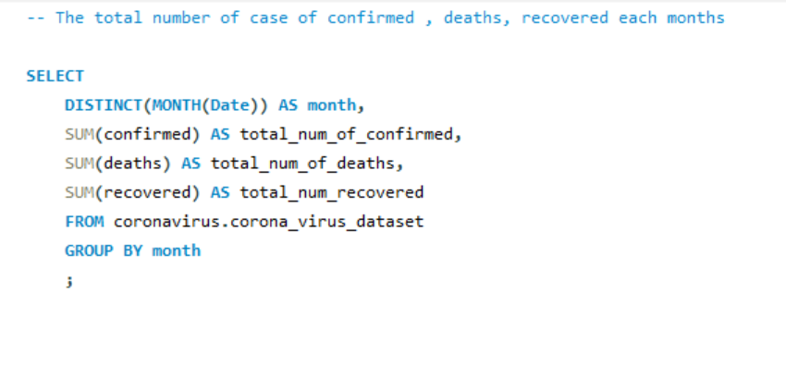
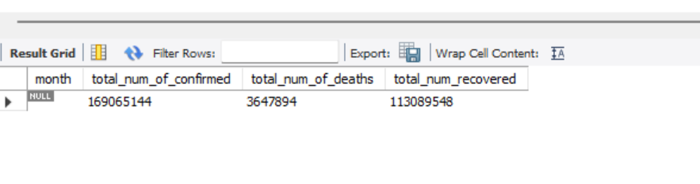
THE TOTAL NUMBER OF CASE OF CONFIRMED, DEATHS, RECOVERED EACH MONTH

Slide 11
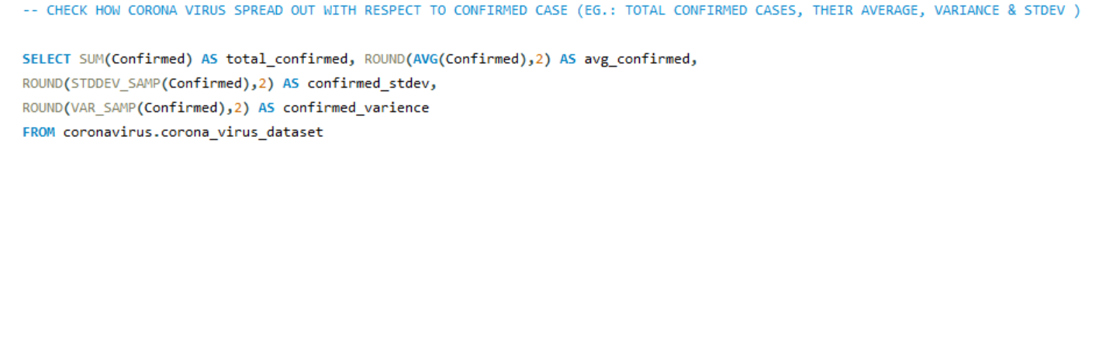
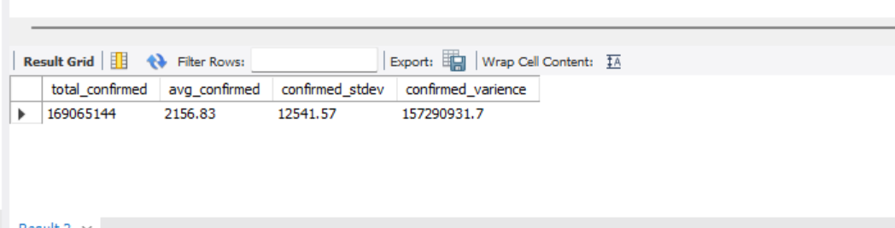
CHECK HOW CORONA VIRUS SPREAD OUT WITH RESPECT TO CONFIRMED CASE
(EG.: TOTAL CONFIRMED CASES, THEIR AVERAGE, VARIANCE & STDEV )

Slide 12
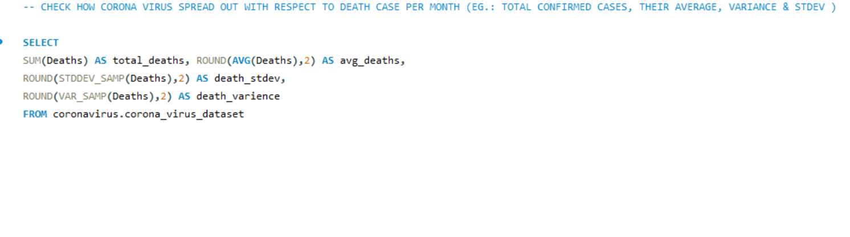
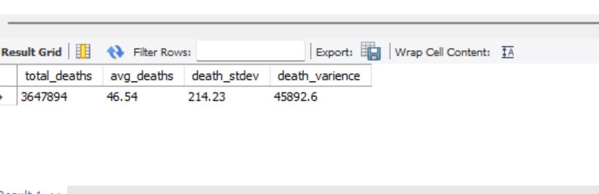
CHECK HOW CORONA VIRUS SPREAD OUT WITH RESPECT TO DEATH CASE PER MONTH
(EG.: TOTAL CONFIRMED CASES, THEIR AVERAGE, VARIANCE & STDEV )

Slide 13
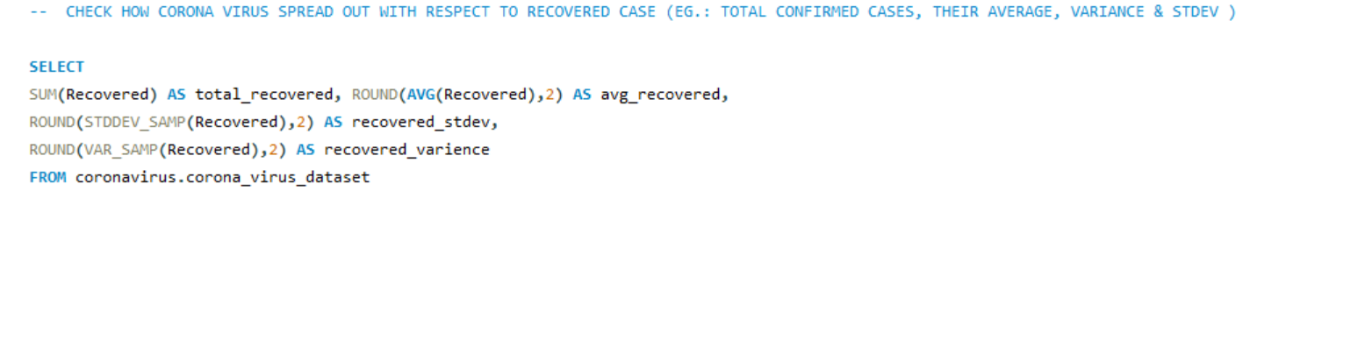
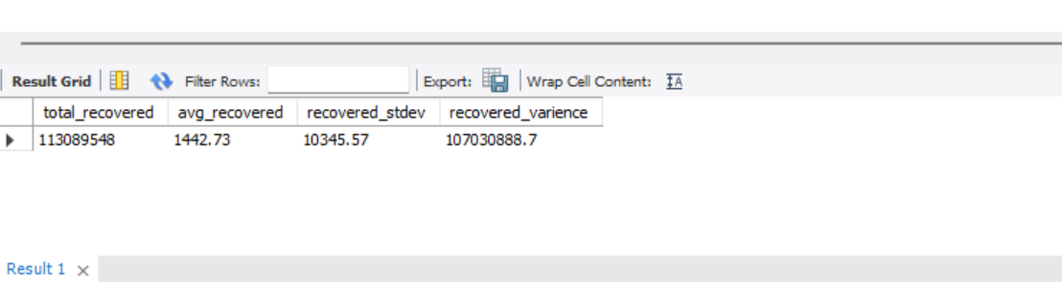
CHECK HOW CORONA VIRUS SPREAD OUT WITH RESPECT TO RECOVERED CASE

Slide 14
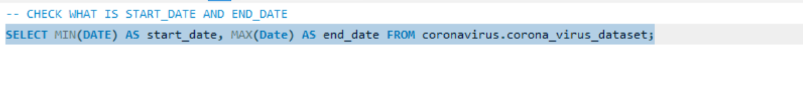
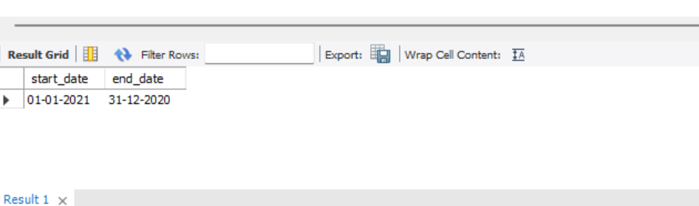
Q. CHECK WHAT IS START_DATE AND END_DATE

Slide 15
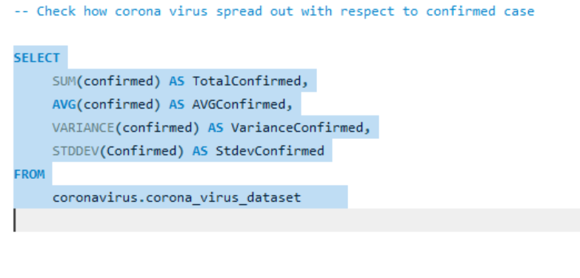
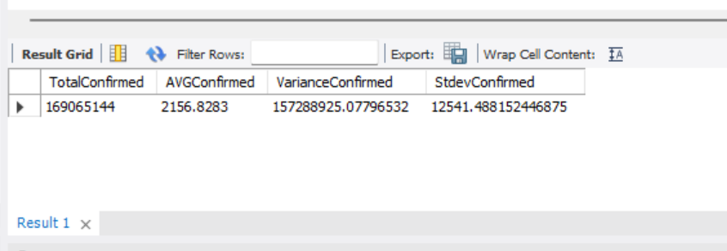
CHECK HOW CORONA VIRUS SPREAD OUT WITH RESPECT TO CONFIRMED CASE

Slide 16
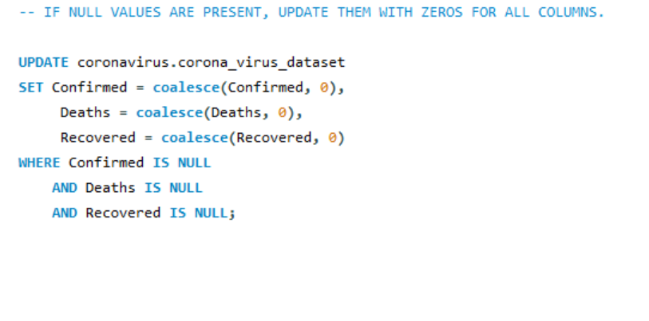
Q. IF NULL VALUES ARE PRESENT, UPDATE THEM WITH ZEROS FOR ALL COLUMNS.

Slide 17
CONCLUSION
Through the utilization of SQL in the MYSQL workbench, this project successfully explored and analyzed COVID-19 data
The objective were met by gathering and cleaning the data, processing it using SQL queries, and answering key questions COVID-19 cases, deaths, vaccinations , and population percentages.
The project highlighted the significance of data exploration and demonstrated the effectiveness of SQL for extracting valuable insights from large dataset.

Slide 18
THANK YOU

